Slide 1
SEPARATION OF SUBSTANCES SCIENCE CLASS 6

Slide 2
SEPARATION OF SUBSTANCES
In everyday life you must have noticed a substance being separated from a mixture of materials.
Ex- Tea leaves are separated from the liquid with a strainer, while preparing tea.
- Grain is separated from stalks while harvesting

Slide 3
SEPARATION OF SUBSTANCES
Give some examples from your everyday lives where you separate substances…..
Examples:-
Separate stones from rice grain
Churning of milk or curd to remove butter
Remove chillies from cooked poha.
Remove husk from grain seeds
Remove tea leaves from tea

Slide 4
NEED FOR SEPARATION OF SUBSTANCES

Slide 5
NEED FOR SEPARATION OF SUBSTANCES
The reasons for separation of substances….
1. To Separate two different but useful components from the mixture
2. To Remove non useful components from the mixture
3. To remove impurities or harmful substances from the mixture

Slide 6
NEED FOR SEPARATION OF SUBSTANCES
The substances to be separated may be particles of different sizes or materials. These may be solids, liquids or even gases.
So, how do we separate substances mixed together if they have so many different properties???
We use different methods of separation and utilise the point of difference between the components of mixture.
Mixture= Component 1+ Component 2+ Component 3 +………

Slide 7
METHODS OF SEPARATION
Different Methods of Separation that we use and will discuss:-
HAND PICKING
THRESHING
WINNOWING
SIEVING
EVAPORATION
SEDIMENTATION/ DECANTATION/ FILTRATION

Slide 8
HAND PICKING
Handpicking: It is the simplest method of separation of substances and commonly used in our homes.
TWO points to keep in mind :
This method is used only when the quantity of impurities or the unwanted material in the mixture is small.
It is also important to note that the shape, size, or color of the unwanted material is different from that of the useful materials.
For example:- a) Pebbles, broken grains and insects are separated from rice, wheat and pulses by handpicking

Slide 9
HAND PICKING EXAMPLES
Hand Picking
Hand Picking

Slide 10
THRESHING
Threshing: Threshing is a method in which grain seeds are separated from the harvested stalks by beating it on a hard surface.
Threshing is of basically three types:
Manual Threshing: When the quantity is small, threshing is done manually. Small bundles of the harvested stalks are thrashed on a hard surface. This helps in separating the grains.
Threshing by Animals: For larger quantities, threshing is done in the traditional way by using animals. For this, stalks are spread around a pole. Several bullocks are tied to the pole and are made to walk over the harvested stalks. Trampling by hooves of the animals helps in separating grains
3. Threshing Machine: Recently threshing machines are used for the purpose. It can be powered by either a diesel engine or an electric motor. It helps in saving time and labour

Slide 12
THRESHING EXAMPLES
Threshing by animals:-
Threshing by Machines:-

Slide 13
WINNOWING
Winnowing is an agricultural method developed by ancient cultures for separating grain from chaff. It is also used to remove weevils or other pests from stored grain.
Winnowing is used to separate heavier and lighter components of a mixture by wind or by blowing air. This method is commonly used by farmers to separate lighter husk particles from heavier seeds of grain.
The husk particles are carried away by the wind. The seeds of grain get separated and form a heap near the platform for winnowing. The separated husk is used for many purposes such as fodder for cattle

Slide 14
CONCEPT BEHIND WINNOWING

Slide 15
WINNNOWING EXAMPLES

Slide 16
SIEVING
Sieve, or sifter, is a device used for separating wanted elements from unwanted material by passing the mixture through typically using a woven screen such as a mesh or net. The basis of separation is the difference between size of particles.
A strainer is a form of sieve used to separate solids from liquid.
Sieving is a very simple, convenient and time-saving process through which particles of varying sizes can be separated from each other with the help of a sieve. A sieve is nothing but a simple device with small pores in it which allow finer materials like flour to pass through leaving behind any impurities it might contain on the top of the sieve.

Slide 17
SIEVING EXAMPLES

Slide 18
EVAPORATION
Evaporation is the process of converting liquid into gas or vapour by increasing the temperature or pressure of the liquid. This process is often used to separate salt from salt water or salty sea water. Sea water has a number of salts present in it.
Shallow pits called evaporation ponds are constructed and salt water is allowed to stand in these. After some time, the water gets evaporated, leaving behind the salts.
Common salt is separated from this mixture upon further purification.

Slide 19
SALT IN SHALLOW PITS

Slide 20
CONDENSATION
Condensation is the process of conversion of gas or vapour into liquid state by decreasing the temperature or pressure of the liquid. Condensation is the change of the physical state of matter from gas phase into liquid phase and is the reverse of evaporation.
The word most often refers to the water cycle.
Evaporation and condensation often takes place together. Evaporation and condensation taking place simultaneously is called distillation.

Slide 21
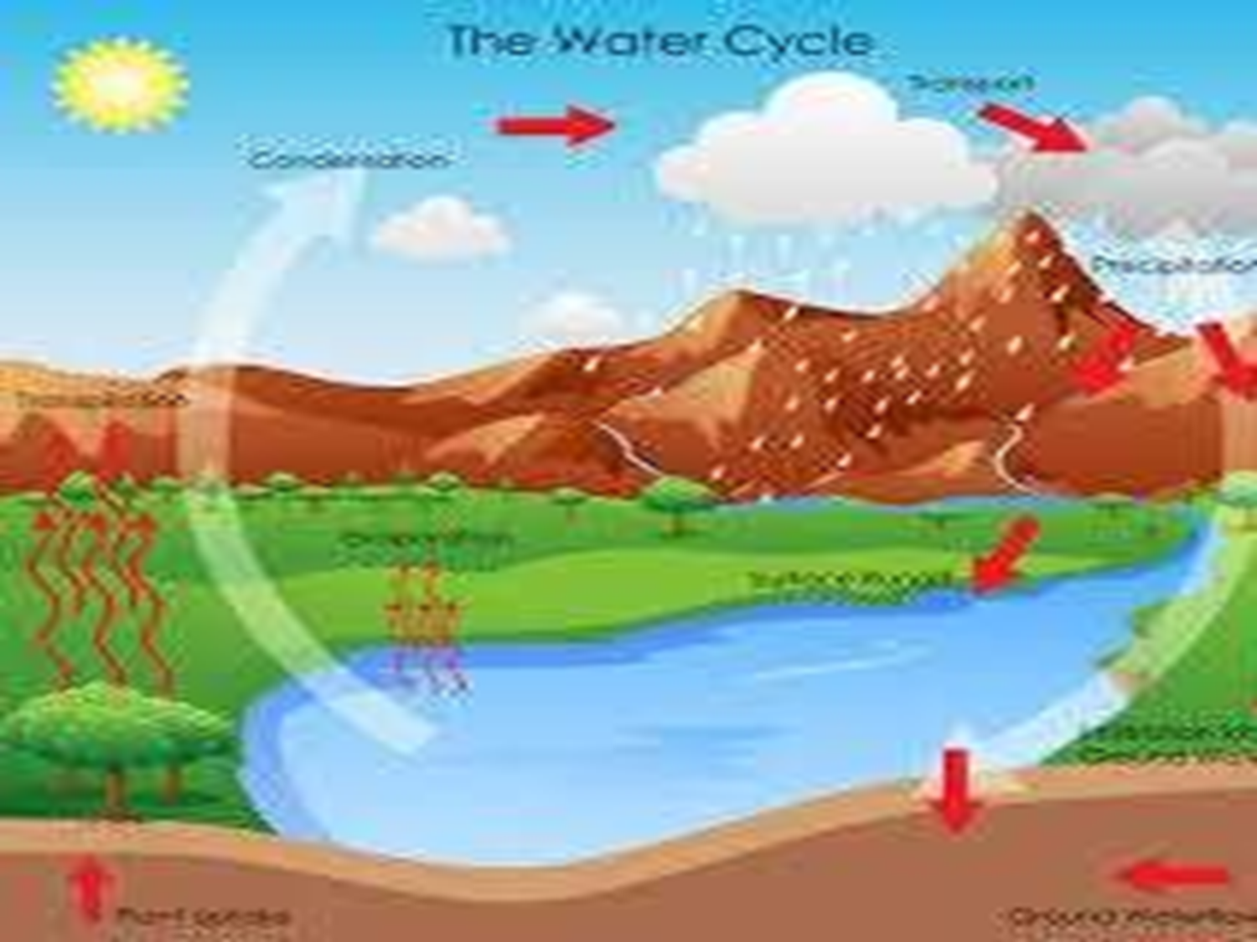

Slide 22
SEDIMENTATION
Sedimentation: Sedimentation can be defined as the process through which dirt and other heavier particles in a mixture settle at the bottom of the vessel when water is added to it. When the heavier component in a mixture settles after water is added to it, the process is called sedimentation
When the dust and dirt particles have settled, the clear water which forms the upper layer is moved to a different container and the dirt and dust is done away with. This technique can also be used to separate two liquids which do not mix with each other (also called immiscible liquids) and is called decantation

Slide 23
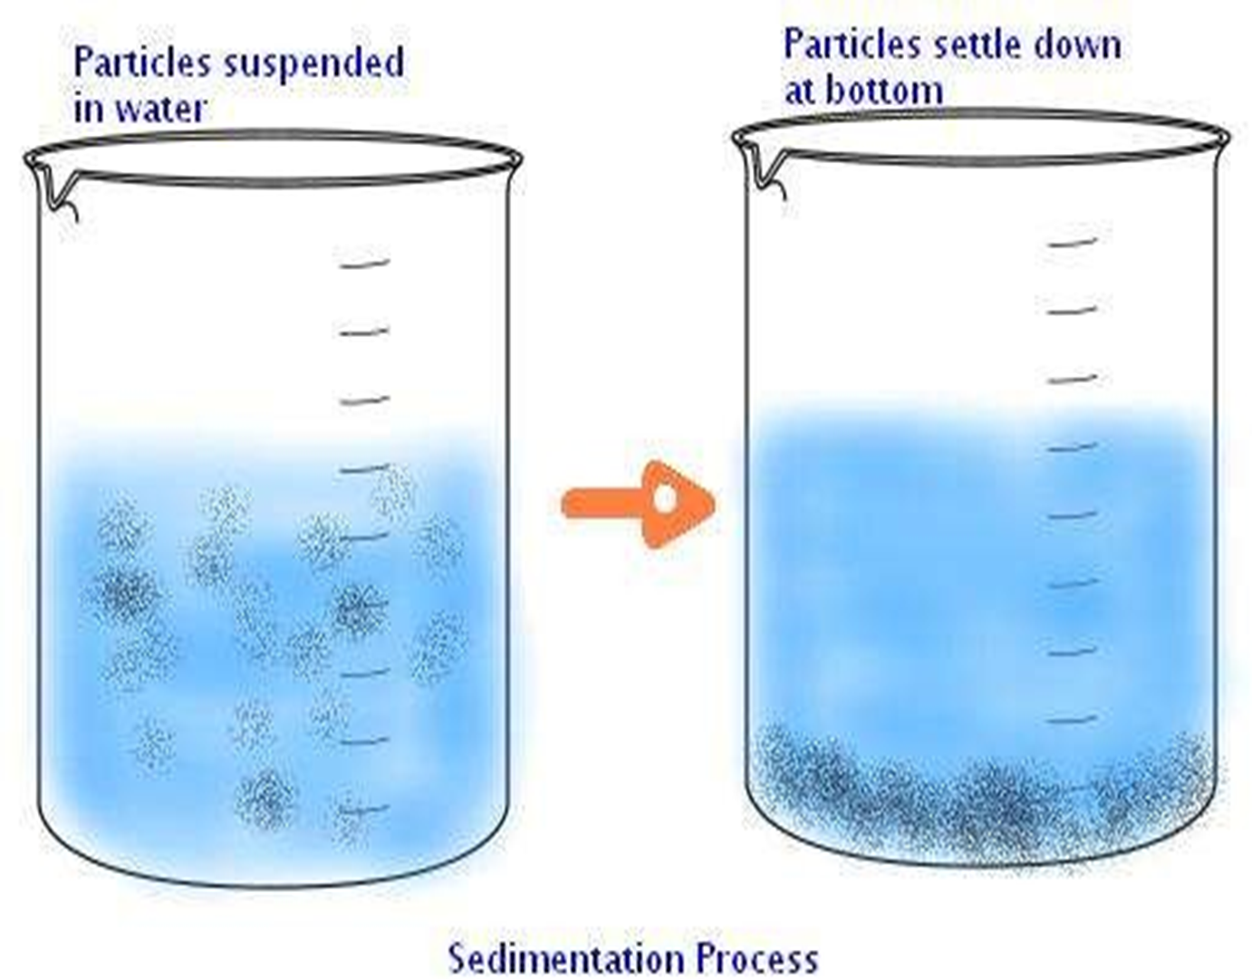

Slide 24
DECANTATION
Decantation is a process of the separation of mixtures by removing water from the mixture where sedimentation has already occurred, by tilting the beaker and slowly pouring the liquid out.
Decantation can be defined as a technique through which immiscible liquids or a liquid and a solid substance are separated.
For ex: Take the case of oil and water. These are two examples of immiscible liquids. Once we pour oil in water, oil forms the upper layer of water and can be easily separated by gently pouring the mixture in another container till all the oil has been removed.
Sometimes smaller dirt particles get carried along with the water in the process of decantation which needs to be further removed. This can be achieved through the process of filtration.

Slide 26
FILTRATION
Filtration is the process through which smaller particles like dirt etc. are separated from a solution by making the solution pass through a medium (often a filter paper). This medium is such that only liquids are able to pass through it because of the presence of very tiny pores in it.
The fluid that passes through is called the filtrate
The filter paper is molded to form a cone and this cone-like structure is then affixed to a funnel through which the dirty solution is allowed to pass. Sometimes, filtration can also be applied to separate pulp and seeds from the juice. It can also be used to separate cottage cheese or paneer from milk.

Slide 27
FILTRATION DONE IN LAB
Method of Folding Filter Paper
Method of using Filter Paper

Slide 28
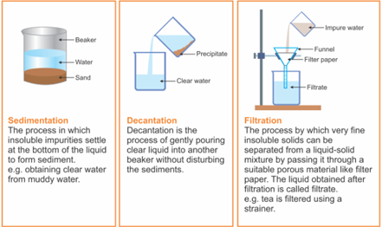

Slide 29
USE OF MORE THAN ONE METHOD OF SEPARATION
Often, we are faced with mixtures and solutions that cannot be separated by use of a single separation technique. A number of such techniques need to be applied simultaneously to achieve the desired result.
Take for example the case of a salt and sand mixture. We know handpicking will not work and considering both of them weigh just about the same, neither will winnowing.
And hence we try to separate the two with the help of filtration or decantation.
We take a beaker and add water to the said mixture of salt and sand. While the salt dissolves in water, the sand deposits at the bottom of the beaker and can be separated from the salt solution with the help of a filter paper or by gently pouring the salt solution in another container. We now have to separate the salt from water, for which we will simultaneously use the methods of evaporation and condensation. While heating the solution in a kettle, we observe that vapour or steam starts to rise from the spout of the kettle. What we then do is allow this steam to come in contact with a metal plate which has some ice on it. When this happens, the steam gets converted to small drops of water which we transfer to another container and thus successfully manage to separate salt which gets left behind in the kettle and the water which we collect in a separate container.

Slide 30
CAN WATER DISSOLVE ANY AMOUNT OF SUBSTANCE
Solution – It is a mixture of a soluble solid in a liquid. Ex- Salt solution, sugar solution
Solution = Solute + Solvent
Solute Solvent vedio.mp4
Solvent- It is the liquid in which solute dissolves. Ex- Water is a universal solvent.
Solute- It is a soluble solid that dissolves in the solvent. Ex- salt or sugar
Solution can be Saturated Solution and Unsaturated solution. Let us discuss what are they?

Slide 31
CAN WATER DISSOLVE ANY AMOUNT OF SUBSTANCE
Even though water can dissolve a number of substances and solutions in it, it has a limit to how much it can dissolve. After a certain point, it stops dissolving any more of that substance and the substance collects at the bottom of the vessel. We say that the solution has become saturated.
A saturated solution is one that contains the maximum possible amount of a particular solute. For example, if we continue to add increasing amounts of salt to a small quantity of water, there will come a point that the salt will not get mixed with the water and instead deposit at the bottom. At this point, we say that the solution has become saturated i.e. it is now incapable of dissolving any more of the given solute which is in this case, salt.
Unsaturated solution is a solution in which more amount of solute can dissolve in a solvent at that temperature.
Saturated solution is a solution in which no more amount of solute can dissolve in a solvent at that temperature.
One way of ensuring that the given amount of water takes more salt even after it has reached its saturation point is by heating the said water. This is because heating the solution helps to increase the solubility of salt or any solute and hence more amount of the same solute can now be dissolved in the same amount of water.

Slide 32
Any Questions…
THANK YOU
BY: NK SINHA

